Slide 1

Funding a Start-up
Evaluating the Business Impact of Funding Types, Sources, Amounts, and Timing
Authors: Aaliyah Hänni, Caleb Case, Kevin Sweet, Jonathan Kerr, Sai Muktevi
Notes:
Jon

Slide 2
Project Introduction
Notes:
Jon
Ideas: Have a graph that’s meaningful but not labeled - as a potential teaser.
Developing a new business takes money, expertise, and time. Most entrepreneurs begin by working a side project off the sides of their desks. If that goes well, the entrepreneur may make the leap to working on their idea full time and fund with their own personal savings.
As a company grows, it often requires the entrepreneur to give up their day job and jump in with both feet - this also includes hiring staff, etc. Personal savings will take you so far but eventually, many entrepreneurs turn to outside investment.
While there are many different kinds of investment, this study will explore two of the most common: seed and venture and seek to understand some underlying relationships that an entrepreneur can benefit from knowing about.

Slide 3
About the Data
Source - Kaggle dataset of Crunchbase (2014 snapshot) ~50k companies
Round - A financing event where a company raises money. The name of the
round gives information about who is investing.
Seed - Early stage investment, used to get. This is
generally the first official fundraising round.
Venture - Professional corporate investors. A.K.A. Venture Capital (VC).
Can often be multiple venture rounds, often with increasing amounts as
the value of the company increases.
* Note: If a company does both a seed and a venture round, the seed round would always take place first!
Notes:
Jon - may need to address that seed != Angel in our dataset
Since a company would never do a seed round after a venture round, we can use a seed round as a predictor of a venture round
Crunchbase?
And now I’m going to turn it over to Kevin to discuss our issues and biases

Slide 4
Issues and Biases
Survivorship bias with almost 70% of data on operating start-ups.
Regional bias with 46.3% of data from USA start-ups among 36% of which was from CA.
Market bias with more information on Software and Biotechnology start-ups.
Inconsistent data dated before the 1980s.
Notes:
Kevin -
Point 1: 90% of startups fail according to the small business administration
Point 2: Focus our analysis on just US startups
Point 3: Overrepresentation of software and biotech startups will affect our funding growth over time findings
Point 4: sparse, decided to focus on 1980-2014
We should discuss how we addressed issues and biases - how we navigated around

Slide 5
Questions of Interest
QUESTION 1
QUESTION 2
QUESTION 3
QUESTION 4
Is the average amount of money raised correlated with the industry the company is in?
Can a company expect to have more financing rounds if they’re in a particular industry?
Does the amount of money raised in the seed round correlate with the year it was raised?
Does the proportion of companies that get seed funding also get venture funding?
Notes:
Kevin - potentially give an abridged version of the questions - including how one leads to another
By the end of this presentation, you will know how much capital you would be expected to raise if you pursued your project ideas as an entrepreneur
What questions are most interesting to entrepreneurs? 1, 2, and 3
What questions are most interesting to investors? 4

Slide 6

Money Raised by Industry
Can you expect to raise more money in specific industries?
Null Hypothesis
The average amount of money raised by a Start-up does not vary by industry.
Assumptions
Normal Distribution
Independence
Equal Variances
Results
Performing the ANOVA F-Test, we found evidence that the average amount of money raised by industries is not equal (p < 0.001).
Interpretation
Based on our analysis, we would expect transportation startups to raise $58 million, about $38 (184%) million more than the average startup in these industries.
* Transportation includes Space-X and Uber
Notes:
Caleb -
It would be good to call out we chose industries that correlate with the other teams, to find out who will likely make the most money fundraising
Transportation includes Space-X

Slide 7
Investment Rounds by Industry
Do different industries experience different amounts of funding rounds?
Null Hypothesis
The average number of financing rounds per industry will be the same
Assumptions
Normal Distribution
Independence
Equal Variances
Results
Performing the ANOVA F-Test, we found evidence that the average number of funding rounds by industries is not equal (p < 0.001).
Interpretation
Based on our analysis, we would expect healthcare startups to have about 2.8 rounds on average, 0.6 (27%) more than the average startup in these industries.
Notes:
Caleb
DAta integers and generally low, so comparisons are at details level
Average just above 2

Slide 8
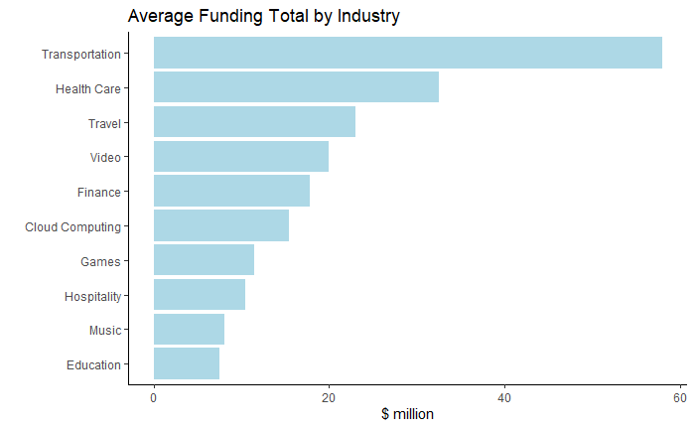
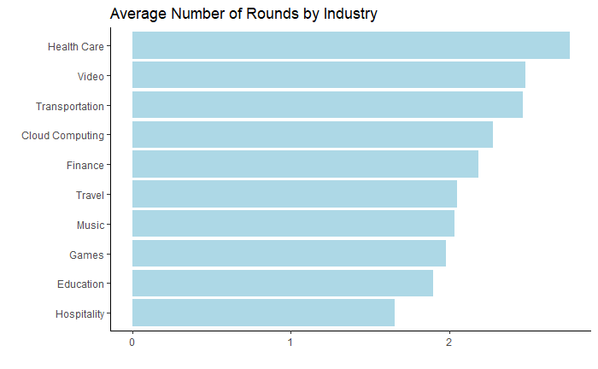
Money Raised and Investment Rounds by Industry
Notes:
Caleb
Not exact, but everything within 2 places
Scale is very different: Over 6x difference between top and bottom in funding, vs ⅔ in rounds

Slide 9
Seed Funding Over Time
How has the amount of seed funding received change in the past 40 years?
Null Hypothesis
Average seed funding amounts are not related to year.
Preliminary Analysis Results
Uniformly distributed proportion of Companies receiving Seed funding.
Seed and Time(years) do not have a linear relationship.
Results
Performing Poisson Regression better described their non-linear relationship.
Interpretation
The regression model showed a 13.5% annual growth in average seed funding over time.
Notes:
Sai -
Another question that might be super interesting to Entrepreneurs. How has the amount of seed funding received change in the past 40 years?
Started off with defining a Null Hypothesis: Average seed funding amounts don’t have any association with Time. Seed neither strictly decreases nor increases over the years.
This question needed a little bit more work to get through the issues and biases.
Did some Preliminary Analysis, which gave us some very useful information to work with, in order to answer our main question.
Some important findings were that:
We confirmed that there was a mostly Uniform distribution in the proportion of Companies receiving Seed funding over the years.
We found that a linear model did did not explain the relationship between Seed and Time well.
Later, based on our findings we finally settled on a model for the data:
We saw that the seed-time relationship was best described by a Poisson Regression model that fit the more non-linear relationship represented in our data.
This also allowed us to test our null hypothesis using the poisson regression, which confirmed enough evidence to reject the null and prove association!
Interpreting the model further, We realized that the seed funding over the years grew more exponentially rather than linearly.
Our biggest takeaway from this analysis was that there was 13.5% annual growth in seed funding over time!

Slide 10
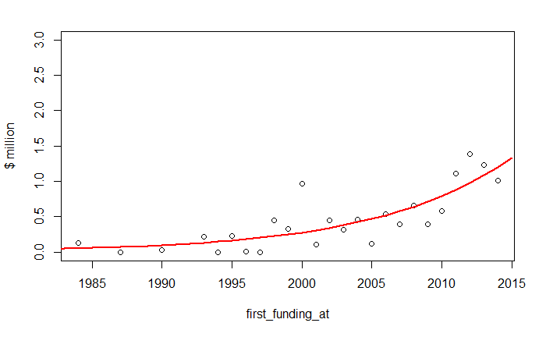
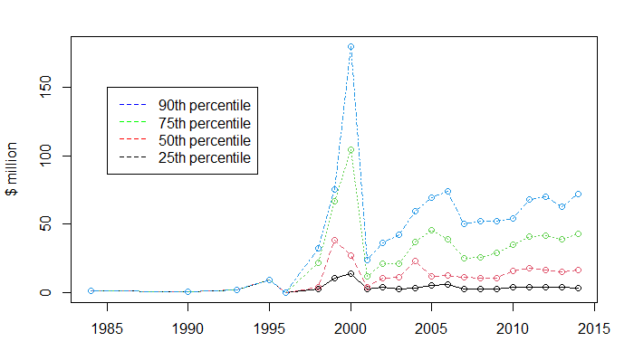
Seed Funding Over Time
Exponential growth and increasing disparity.
13.5% Annual growth in the average seed funding.
The top gets bigger but the bottoms stays flat.
Dotcom bubble
first_funding_at
Notes:
Sai ([Note to speaker]: You’ll need to discuss the dollar values on the Y axis.)
for both graphs: Y-axis shows $ values in millions and X-axis shows year of receiving the seed which is first funding amount.
Left: seed vs year with our poisson regression model, looks to be a good fit
We Expected
A direct relationship between average seed funding and time.
Found
A log-linear relationship with a 13.5% annual growth in average seed investments into startups over time!
Right:
A different perspective looking at the seed funding amount as percentile divisions of companies over the years.
To understand better what we show here is that each point on the graph shows, say for the 90th percentile, that 90% of companies received funding amounts that much or lower in millions as a reading on the Y-axis and the year from the X-axis.
That big spike is the dot-com bubble an instance where capital markets kept fueling the start-up race, till everything crashed.
What’s interesting is that even after the big crash, the amount of money raised via seed investments kept growing after that big dip.
The companies at the top levels show an increasing trend but the ones at bottom stay flat in terms of investments (except during the dot-com bubble! Which is also interesting).
This graph also shows that the range of funding amounts increased over time!
Now moving on, Aaliyah will talk more about seed funding and venture funding relationships.

Slide 11
Seed and Venture Funding
Does the proportion of companies that get seed funding also get venture funding?
Null Hypothesis
The proportion of companies that receive seed funding are just as likely to receive venture funding
Assumptions
Zero values for seed funding indicate that the company did not have a seed round
All money raised in seed round was reflected in seed round column in data
Results
We found that the companies who did not have a seed round were nearly four times as likely to have a venture round.
Interpretation
This result does not coincide with our domain knowledge, further study will need to be done to validate these results.
Notes:
Aaliyah -
A question of interest for investors is, does the proportion of companies that receive seed funding also get venture funding?
Null Hypothesis: Receiving seed funding should not impact whether or not an industry has a venture round
Expectation: Companies that have a seed round are more likely to get venture funding, because as Jonathan said, if a company has both, a seed round always comes before venture.
Results: We found that the companies who did not have a seed round were nearly four times as likely to have a venture round.
This is shocking, as our personal experience and understanding of seed and venture funding led us to believe that we would get complete opposite results -> that companies who did not have a seed round would not be as likely to get a venture round
So… Why?
Either we are biased or our data
On the next slide...
For Reference:
Test Used: Chi Square Test for Independence
Results: Variables are dependent
Interpretation: What we expected vs what we found

Slide 12
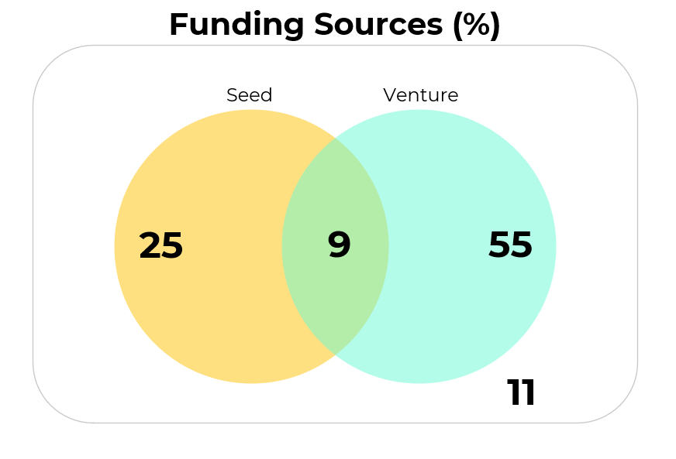
Seed and Venture Funding
Notes:
Aaliyah -
Researching this question we found:
We found that, “only 0.05% of startups raise venture capital.” While, in our dataset 64% of startups raise venture capital. This led us to the conclusion that the is a result of our dataset being heavily biased towards successful startups.
However, researching this question further, showed that there are instances where startups will go straight to venture funding such as when the founders have prior experience, long-standing relationships, reasonable non-experimentive markets. But these tend to be the expectation, rather than the rule.
For Reference:
Use of Bayes Theorem
P(venture | seed) = 0.28
P(venture | !seed) = 0.81
Seed -> Venture
Expected: A company that has a seed round is more likely to have venture round
Results: 4x as likely to get venture funding if you do not have a seed round
Why? Biased data or biased opinions

Slide 13

Key Findings
The average amount of money raised varies by industry
The average number of rounds varies by industry
The average amount of seed money invested is increasing 13.5% annually
Against our expectations, companies that didn’t do a seed round are 4 times more likely to have a venture round
Notes:
Aaliyah -
Summarizing the results of all the hard work of our team ...
1.
Of the groups presenting today we would predict Airline cancellations to raise the most as a startup.
2.Unexpectedly...
3.
4.
For reference:
Original Questions
Is the average amount of money raised correlated with the industry the company is in?
Can a company expect to have more financing rounds if they’re in a particular industry?
Does the amount of money raised in the seed round correlate with the year it was raised?
Does the proportion of companies that get seed funding also get venture funding?
Want to enter values..

Slide 14

THANK
YOU!!!!!
https://github.com/kevSweet/Startup-Analysis
Notes:
Questions?

Slide 15
Cited Sources
Case, C., Hänni, A., Kerr, J., & Muktevi, S. , Sweet, K., (n.d.). Kevsweet/startup-analysis. Retrieved March 09, 2021, from https://github.com/kevSweet/Startup-Analysis
Entis, L. (2013, November 20). Where Startup Funding Really Comes From. Entrepreneur. Retrieved 3 6, 2021, from https://www.entrepreneur.com/article/230011
M, A. (2020, February 17). StartUp investments (Crunchbase). Retrieved February 13, 2021, from https://www.kaggle.com/arindam235/startup-investments-crunchbase
SBA. "2020 Small Business Profile" Accessed Mar. 6, 2021.
Wood, M. (2020, February 3). Raising capital for startups: 8 statistics that will surprise you. Retrieved March 09, 2021, from https://www.fundera.com/resources/startup-funding-statistics
Notes:
Add Github link

